Slide 1


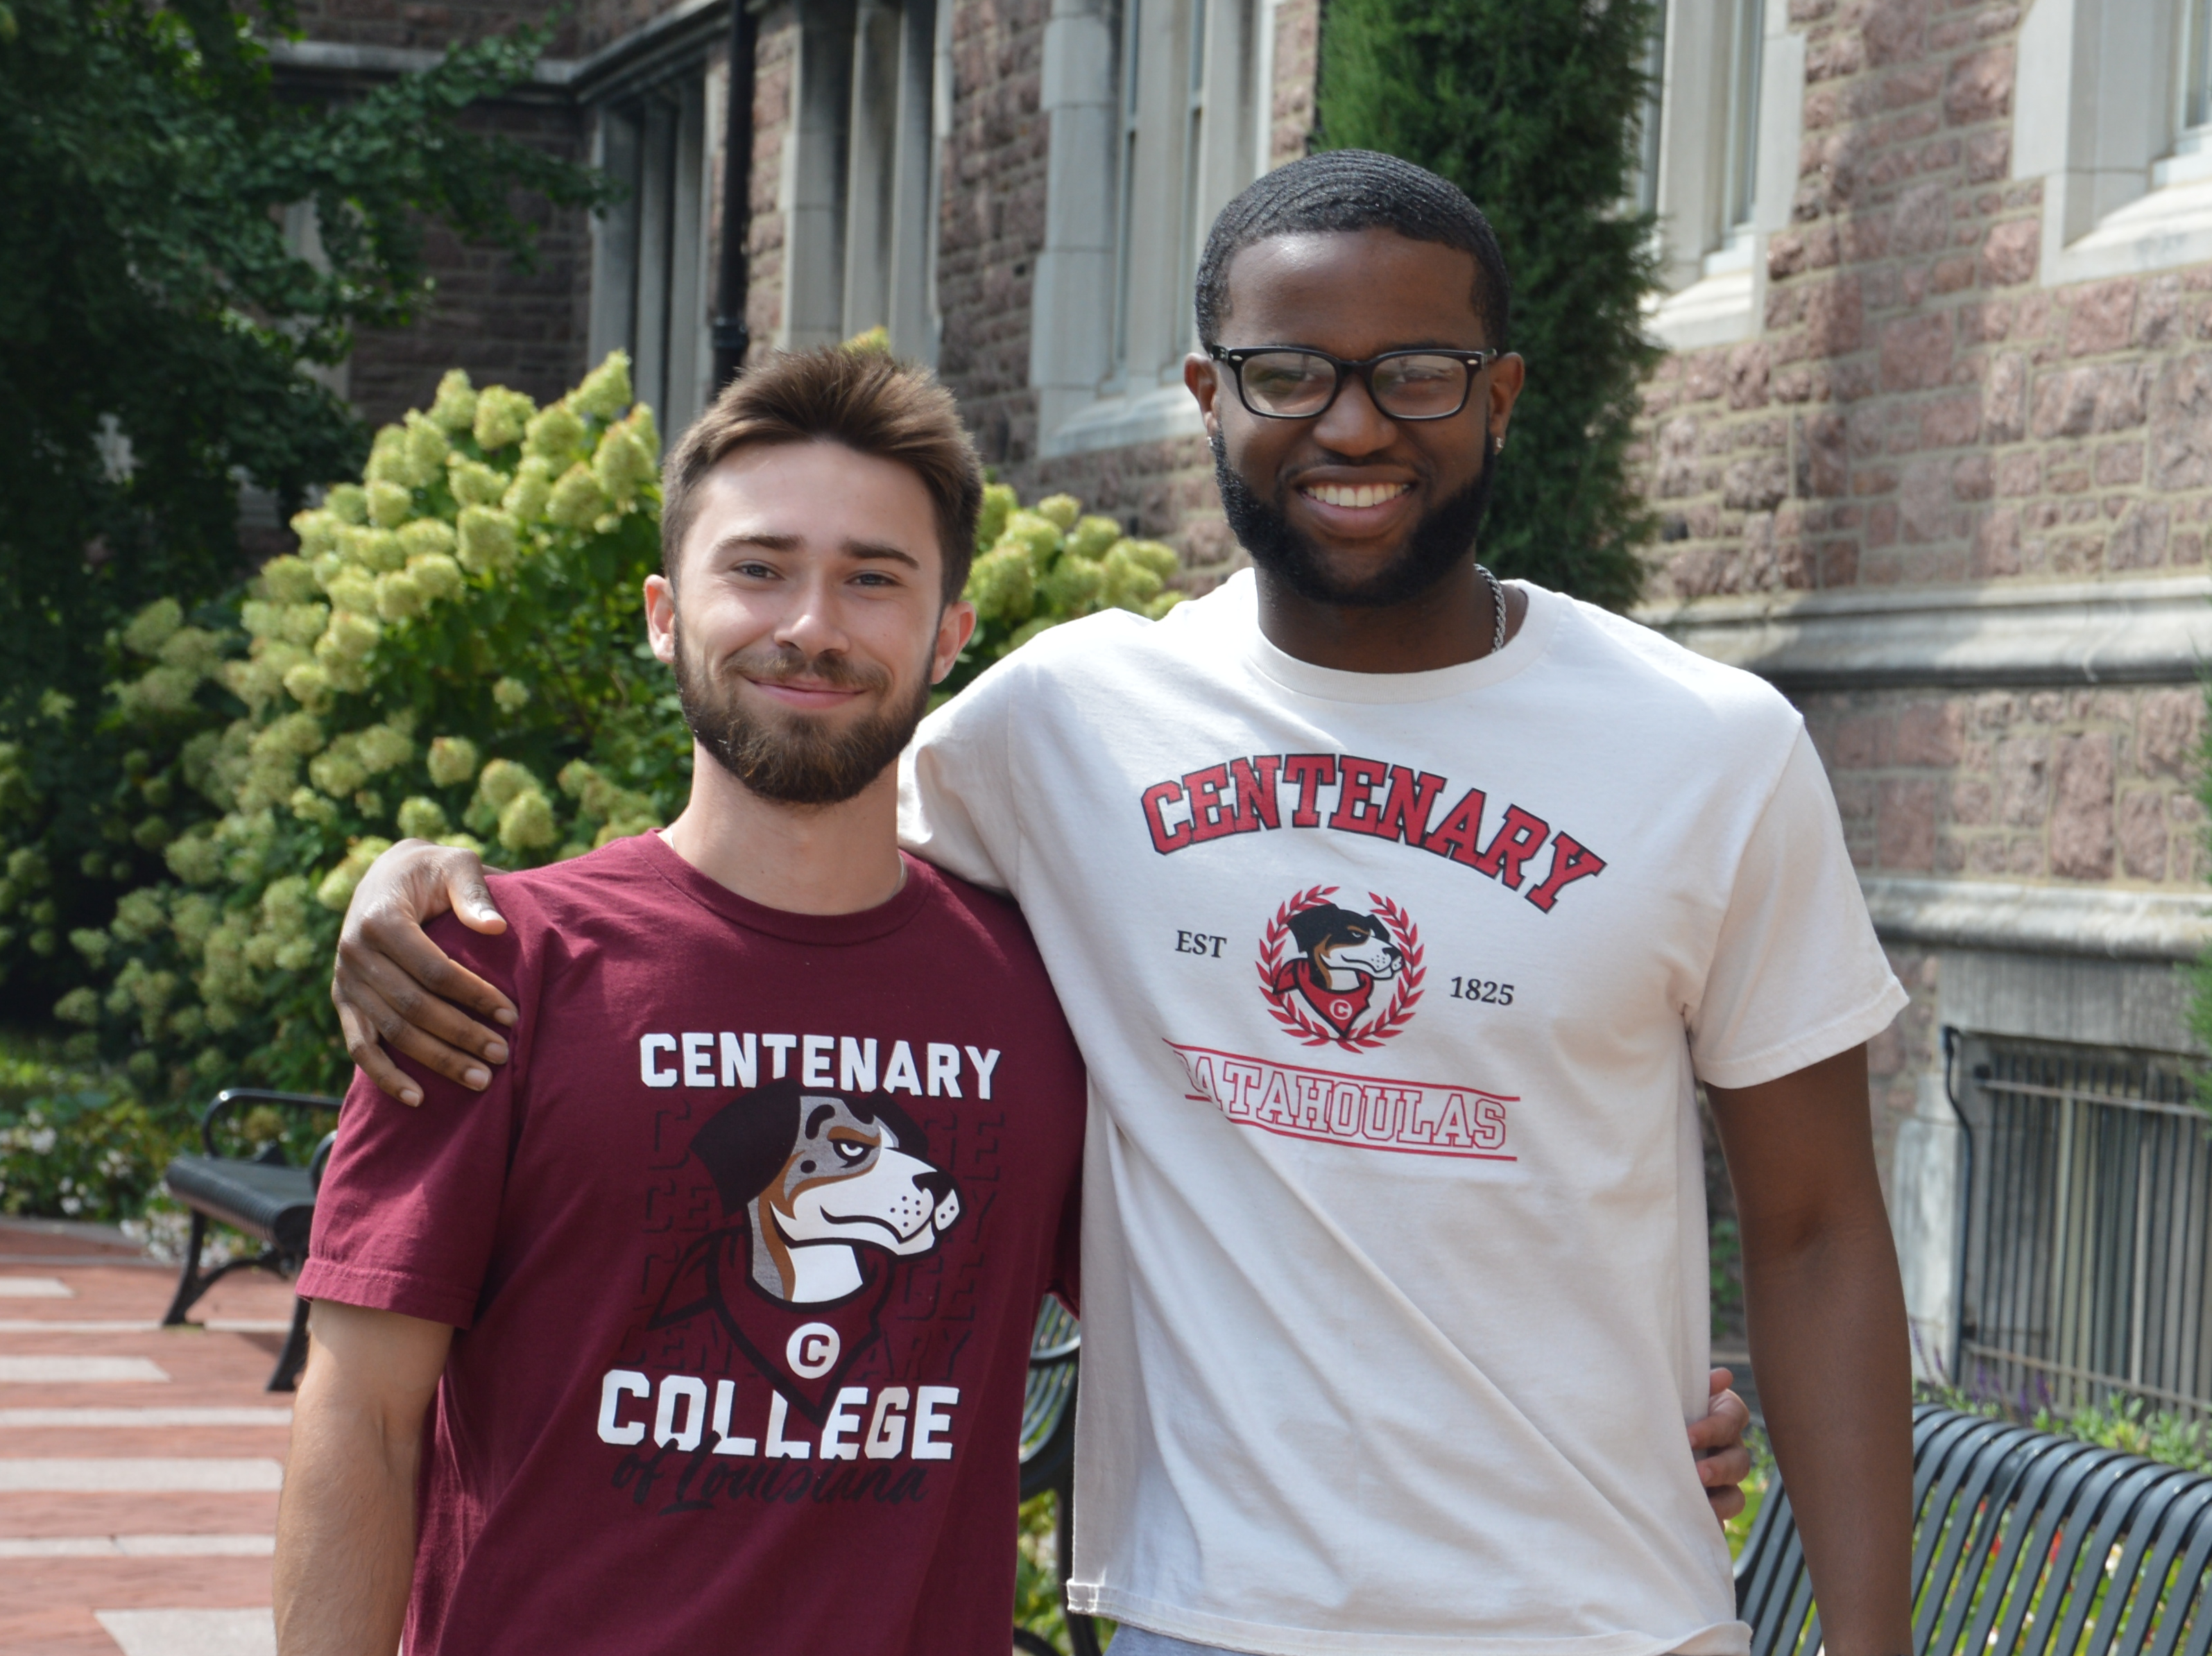
Engineering Dual Degree Program
The liberal arts approach to engineering education
Centenary College of Louisiana partners with Washington University in St. Louis to make engineering education accessible to liberal arts students. Created in 1973, the Engineering Dual Degree Program fosters a community of well-rounded engineers who are uniquely positioned to bring both breadth of skill and depth of knowledge to solving problems and improving lives.
During your three years at Centenary College, develop valuable foundations in academic, communication and social skills.
During your three years at Washington University, gain analytical acumen, technical knowledge, and engineering insight.
At both institutions, benefit from career services, experiential learning, peer support, faculty advising, alumni networks, and more!
Clear criteria lead to predictable Engineering Dual Degree admission.
With advisory help from Centenary, include pre-engineering requirements in Centenary coursework.
Achieve a 3.25 cumulative GPA and a 3.25 STEM GPA in at least 90 Centenary credit hours.
In year 3 at Centenary, submit a free application to WashU to verify the qualifications above.
Engineering Dual Degree students build diverse credentials during six college years.
Transfer Centenary credits to WashU and, later, transfer WashU credits to Centenary.
Within the first two years at WashU, earn undergraduate degrees from Centenary and WashU.
After a third year at WashU, also complete an engineering master’s degree from WashU.
All Engineering Dual Degree students receive a three-year scholarship at WashU.
The Graduate Affiliation Scholarship is automatically awarded to all admitted students.
The Graduate Affiliation Scholarship provides a 50% tuition discount for six semesters of study.
Students may submit a separate application to be considered for an additional (merit) scholarship.
Centenary engineers at WashU: Dylan and Coby
Attending Centenary College opens a door and defines a pathway to engineering education at WashU. For more information, please visit centenary.edu and engineering.washu.edu.

