Slide 1
Administrative Unit
Program Reviews
The 2026 Template

Slide 2
Goal for today’s meeting
Introduce the three-year cycle
Introduce the new template
Develop a better understanding of quantitative data-driven assessment

Slide 3
Three-Year Cycle
Cycle 1 – Fall 2026
Cohort 1 {AA (7) with Trek (4)} – submits full program report Nov. 16
Cohort 2: {SL (4), Dev (3), Ath (1)} – submits partial report Dec. 1
Cohort 3: {Fin (6), EM (3)} – submits partial report Dec. 1
Cycle 2 – Fall 2027
Cohort 1 – collects data for Fall 2029 program report
Cohort 2 – submits full program report in Fall 2027
Cohort 3 – collects data for Fall 2028 program report
Cycle 3 – Fall 2028
Cohort 1 – collects data for Fall 2029 program report
Cohort 2 – collects data for Fall 2030 program report
Cohort 3 – submits full program report in Fall 2028
Notes:
Cohort = people
Cycle = Timeline
Data collection still has to occur yearly, even if you cohort report is not due in that year.
Fall 2026 cohort data = 2025-2026 – 2026-2027 and planning for 2027-2028, 2028-2029, 2029-2030
Fall 2027 cohort data = 2025-2026 – 2026-2027 – 2027-2028 and planning for 2028-2029, 2029-2030, and 2029-2031
Fall 2028 cohort data = 2025-2026 – 2026-2027 – 2027-2028 and planning for 2029-2030, 2030-2031, and 2031-2032

Slide 4
Why the Change?
Consistency
Clarity (Program report ≠ Unit report)
Highlight continuity of assessment cycle
Moving to 3-year cycle
  Necessary data collection every year
Notes:
Consistency – reports look more alike
Clarity – providing greater guidance and clearer expectations
Highlighting continuous improvement – hoping new structure will provide better alignment with the assessment process
3-year rotations - The focus shifts from completing an annual report to documenting continuous improvement over time
Eliminate the highlighted part? Should this be in front of the three-year cycle and new template slides?

Slide 5
Restructured Reviews
Previous template
New Template
Purpose Statement
Goals and Outcomes / Objectives
Method of Assessment
Assessment Finding and Achievement of Basic Educational Goals Articulated in College Purpose Statement
Planning
Implementation of best practices
Introduction of the Unit/Header
Introduction of Unit/Purpose of Unit
Goal1
  Objectives, Methods, and Measures
  Supporting Information
  Assessment Findings / Use of Data
Goal2
  Objectives, Methods, and Measures
  Supporting Information
  Assessment Findings / Use of Data
Planning
Implementation of Best Practices
Notes:
Looks like the same thing… but
Designated place for identifying the unit, the person who completed it, what cycle is the unit on, etc.
With the introduction, we are no long assuming that the reader (Centenary, IEC, VP, The Commission,…) already knows and has a sense of what your unit does and/or is responsible for.
Targeted questions about your unit
The new template encourages you to complete the assessment of one goal before moving into the next one.
Name the Goal
Identify the Objectives to meet the goals
Describe how you will be collecting the data
Then, provide the data, to show:
Target – where you aim to be
Benchmark – where you are starting
Actual – where you landed
Results – Did you meet the stated goal?
Supporting Information – to provide additional context to help you and the reader(s). This completes the picture
Findings
IMPORTANT: State of the Goal – Met, Not Met, Partially Met
Discuss what you learned from the data collection – and close the thought on this goal
If the goal was not met, what are the next steps to meet the goal next time?
If the goal was met, what changes will be made to push your unit further forward?
Name Goal 2 and do the same.
Planning
Since this is now a three-year cycle, this truly becomes the “what will we be doing / collecting over the next three years?”
Best Practices

Slide 6
Part 1 - Introduction of Unit
Provide a brief general description about your program/unit,
Include the following:
  Your division, location, staffing
  Special reporting – either external or internal – that your unit completes for the institution, etc.
Include external accreditations (e.g., NASM) or special circumstances related to the program (e.g., TREK requirements).

Slide 7
Example:
Institutional Research
Institutional Research (IR), housed in the Provost Office suite in Hamilton Hall, is responsible for completing federal and state reports, such as IPEDS on behalf of Centenary. IR is a collaborator on data collection for internal and external reporting needs, including data capture of official Census-day enrollment information used for assessment and accreditation. This one-person office serves on institution-level committees, including the Student Support Team, Institutional Effectiveness, Institutional Review Board, and other groups as appointed by the Provost.

Slide 8
Part 2 – Purpose of Unit
Note: Thinking about this can help determine goals
Unit Mission Statement
Unit link to the Centenary’s Mission and Vision
Subunits, other departments, programs, and areas
Services offered
Customers
Contributions to retention and graduation
Reporting you complete on behalf of Centenary
Notes:
When the Mission and Vision statements change, this will require a review and potential update of the unit missions statement. Watch for official approvals from the Cabinet and Board of Directors.

Slide 9
Example:
Institutional Research (Mission Statement)
The Office of Institutional Research (IR) at Centenary College of Louisiana strives to provide actionable, accurate, appropriate, and timely information to the administration and community that supports decision-making processes on various levels across the College. IR is the central source of official institutional information, including Census data which is used to report to the US Department of Education and other agencies. IR also collaborates with Centenary stakeholders to foster a culture of continuous improvement and enhance student learning and engagement experiences.

Slide 10
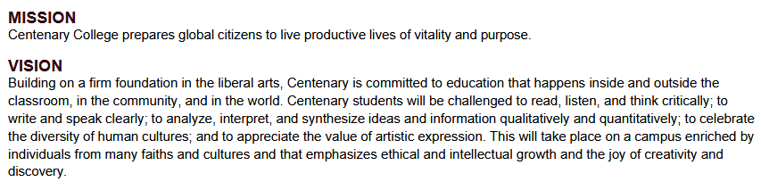
Notes:
When the Mission and Vision statements change, this will require a review and potential update of the unit missions statement. Watch for official approvals from the Cabinet and Board of Directors.

Slide 11
Example: Institutional Research (Linkage to College Mission and Vision statements)
Institutional Research collects and maintains enrollment, retention, and graduation data which is directly used within the Strategic Plan, as well as by departments across Centenary.

Slide 12
Subunits, other departments, and areas
(not applicable to all units) (new)
Does your unit house different functional areas or does it oversee particular groups? Some of these will have specific reporting for internal groups and external agencies and possibly accreditation reporting.
Thinking about these areas in the context of your unit will inform unit goals, reporting, and the assessment cycle
If applicable, describe these various areas of your unit

Slide 13
Subunits Examples:
The Learning Commons houses Advising, Student Disabilities, Learning Resource Center, Peer Mentoring.
Residence Life works with Resident Assistants

Slide 14
Contributions to Retention and Graduation (new)
How does your work help already-enrolled students have a positive experience that encourages them to return and ultimately complete their degree?

Slide 15
Example:
The Fitness Center
The Fitness Center provides spaces, facilities, and programs to help students develop personal wellness and build community around shared physical activity. We have space for campus and community events to provide a vibrant campus environment.

Slide 16
Special Reporting Responsibilities (new)
Does your work help address/report any major statutory, regulatory, or compliance requirements? If so, which ones? (e.g., federal, state, local, grant, external accreditation, degree requirements, consultants, etc.)
Briefly describe special reporting responsibilities (beyond those previously described) that your unit completes on behalf of Centenary
Notes:
Reporting for accreditation agencies beyond The Commission

Slide 17
Examples of special reporting responsibilities
Accreditation from an association or agency
(e.g., NCAA, NASM, AAM);
Reporting
(e.g, CUPA, NACUBO, Clery Act, National Student Clearinghouse, FISAP, GDPR, IPEDS);
Consultants or auditors
(e.g., Ruffalo Noel-Levitz, Credo, EAB, Forvis);
Grants
(e.g., Louisiana Board of Regents grants, CIC grants);
Others

Slide 18
Parts 3 and 4 – Assessment cycle for Goals
(Goal 1 and 2)
The broad “thing” your unit hopes to achieve
The measurable way you will get there
The data you will collect along the way
What did you learn from the data?
Was your goal met - not met – or partially met?
How will your unit respond to bring about improvement?
Notes:
Bring about improvement, even if the goal was met. We should not state “we will continue to monitor progress.”

Slide 19
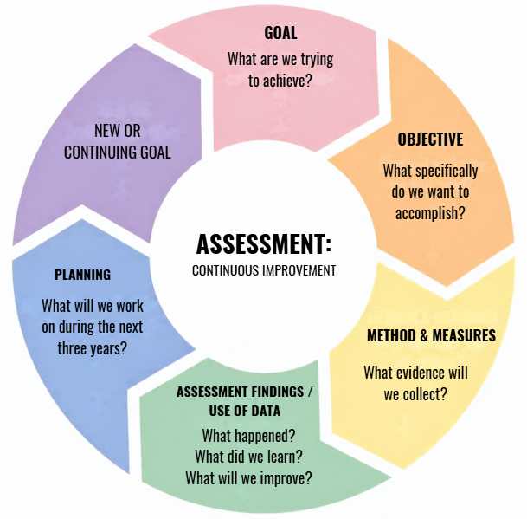
Notes:
Before getting into the template, I thought we could review the flow in another format. We can state how once the unit introduces itself, the template exists to document each part of the cycle.

Slide 20
What is a Goal?
A broad "thing" your unit hopes to achieve.
Remember:
Not every activity in your unit needs a goal.
Focus on what is most important to your unit or improvement .
A goal can be broad enough to support multiple objectives.
Notes:
A frequently noted comment by IEC in administrative program reports last year was that the goals and objectives do not need to be all-encompassing for the unit.
Everything the unit does is not quantifiable and therefore does not need to represented here
The program report for "The Commission" needs to focus on aspects of the unit that lend themselves to being quantifiable.
A comment to that effect would be appropriate somewhere here.
*Goals themselves should not be measurable. They become measurable through the objectives used to obtain the goal.

Slide 21
Sample Goal 1: Office of Admissions
Goal
  To recruit a substantial number of diverse, well-rounded, quality students who will enroll and subsequently graduate, thereby contributing to a vibrant and healthy campus community.
Description of goal:
  To increase undergraduate enrollment at Centenary, as well as offset the number of students who are graduating from Centenary each year, as well as the number of students transferring out of Centenary, the Office of Admissions should be recruiting and ultimately enrolling enough students to maintain a healthy balance.
Strategic Connection:
  Bold at the Bicentennial, Goal 2 Grow Enrollment
Notes:
Explaining the bottom boxes:
New: Something started for this cycle.
Continuing: Something that has been brought forward from the last cycle. Review strategic planning linkage and how long this goal has remained unchanged.
Completed: Something that was brought forward from the last cycle but is now considered to be resolved. Provide assessment to explain the conclusion of goal. New Goal needed for next cycle.
Discontinued: Something that was brought forward from the last cycle but is now inactive due to significant changes. Provide assessment to explain the conclusion of goal. New Goal needed for next cycle.

Slide 22
Goal Status
For the current cycle, what is its status?
New
Continuing
Completed – explain conclusion of goal and create a new one
Discontinued - explain conclusion of goal and create a new one
Notes:
Option if last slide is too busy – I don't think this needs much attention
New: Something started for this cycle.
Continuing: Something that has been brought forward from the last cycle. Review strategic planning linkage and how long this goal has remained unchanged.
Completed: Something that was brought forward from the last cycle but is now considered to be resolved. Provide assessment to explain the conclusion of goal. New Goal needed for next cycle.
Discontinued: Something that was brought forward from the last cycle but is now inactive due to significant changes. Provide assessment to explain the conclusion of goal. New Goal needed for next cycle.

Slide 23
What is an Objective?
A specific accomplishment that supports your goal.
Remember:
Include a numerical target.
Include a timeframe.
Be specific.
A goal may have multiple objectives.

Slide 24
Sample Objective 1.1 - Office of the Admissions
Increase total application, admit, and deposit numbers from the prior Fall 2024, with the first-time full-time undergraduate enrolled cohort for Fall 2025 to be 245 students.
Notes:
Just an example. Not necessarily a real goal.

Slide 25
Results and Measures - Method
What quantitative data will you collect to measure progress toward the objective?
e.g. surveys, completion rates, attendance at events, numbers served
What numerical target defines success?
e.g. 80% satisfied, 10% increase in attendance or
numbers served

Slide 26
Office of Admissions
Method:
Straightforward comparison of the total number of students in each funnel point, current year actual to prior year’s actual. Though data is collected daily, actuals reported here are captured as of the census date for each fall term. Additional calculations for yield are included to inform movement between the funnel points for Application to Admission, Admission to Deposit, and Admission to Enroll. Source of data: Slate.

Slide 27
Results and Measures (continued)
Present the data collected
Compare results to numerical target
State if the target was achieved
If applicable, repeat for other objectives within the goal

Slide 28
Office of Admissions, continued
The Application Funnel
1.1.a. - Applications, first-time full-time undergraduates
1.1.b. - Admissions, first-time full-time undergraduates
1.1.c. - Deposits, first-time full-time undergraduates
1.1.d.- Matriculants, first-time full-time undergraduates
PLUS, Supplemental data break downs. Maybe athletes, non-athletes, transfer students, students of color, etc.
 | Target | Actual | Difference | % Difference | Yield | Result
Fall 2022 |  | 173 |  |  | 27.2%
Fall 2023 |  | 255 | 82 | 41.1% | 27.9%
Fall 2024 |  | 232 | -23 | -6.8% | 27.1%
Fall 2025 | 245 | 220 | -12 | -8.5% | 25.8%
Notes:
Each funnel point would have some kind of way to record the outcomes.

Slide 29
Meeting Goals
What if I don’t meet my goals?

Slide 30
Assessment Findings / Use of Data for Goal 1
Goal was ☐ MET or ☐ NOT MET or ☐ PARTIALLY MET
Assessment findings and use of data to improve services.
What was learned? State what is being done (or has been done) to improve.
If the goal was met, briefly explain the factors contributing to this outcome and identify steps to sustain or build upon results. This might be a time to expand or modify your goal - or find a new goal, if appropriate.
If the goal was not met, briefly explain why and the actions being taken to meet the goal in the future.
Notes:
Do not say “we will continue to monitor”

Slide 31
Part 5 - Planning
This is super important, especially with the change to a three year cycle
What will you be working on in the next three years?
  Think about the same questions from the Goal sections
    What is it
    Where are we now and why is this important
    Is it new, how long have we been saying that we will do this, …
    How will we be collecting data, What data, How often, …
    What does success look like
Notice how this automatically sets up Parts 3 and 4, or at least it should

Slide 32
Next Three Years
What outcomes will your unit assess over the next three years?
Reflect:
  Is it time to consider to a different goal, objective and results?
  How long have you been using the same metrics?
Complete the following with your planned goals, measurable objectives, and description of results and methods that you will be using for the next three years.

Slide 33
The Goal(s)
☐ New ☐ Continuing
Goal: Add language here
Description: Add language here
Notes:
At least 2

Slide 34
The Measurable Objective(s)
☐ New ☐ Continuing
Measurable Objective: Add language here
Description of Results and Measures 1.*, with method for collecting data Add language here
Notes:
Repeat this

Slide 35
Part 6 - Best Practices
Describe how the program/unit is attempting to implement the best practices in the particular field of expertise.
Examples include the use of outside peer-reviewers, national association or reporting standards, unit specific guidelines, professional training, nationally-stated discipline-specific outcomes, etc.
State how the use of these practices will improve the efficiency of your program/unit.

Slide 36
Office of Admissions
The Office of Admission belongs to all the major admission and enrollment organizations, on both a regional and a national basis:
NACAC, SACAC, TACAC as well as AACROA, LACRAO, and TACRAO
These organizations provide networking and advanced education opportunities. We use them for training new team members by sending them to “summer camps” as well as by attending and participating in annual conferences where many of the latest approaches to recruitment are discussed.
… and so on …

Slide 37
Conclusion
Cycle 1
  November 16th
  Full Report
Cycle 2 and Cycle 3
  Introduction, Planning and Best Practices
  December 1
Notes:
Cohort = people
Cycle = Timeline
Data collection still has to occur yearly, even if you cohort report is not due in that year.
Fall 2026 cohort data = 2025-2026 – 2026-2027 and planning for 2027-2028, 2028-2029, 2029-2030
Fall 2027 cohort data = 2025-2026 – 2026-2027 – 2027-2028 and planning for 2028-2029, 2029-2030, and 2029-2031
Fall 2028 cohort data = 2025-2026 – 2026-2027 – 2027-2028 and planning for 2029-2030, 2030-2031, and 2031-2032

